Slide 1



Foundations for Restraining Bolts:
Reinforcement Learning with LTL_{f}/LDL_{f} restraining specifications
Reasoning Agents
Sara Tozzo
1483104
Giorgia Piernoli
1648511
Flavio Lorenzi
1662963
Nicolò Mantovani
1650269

Slide 2
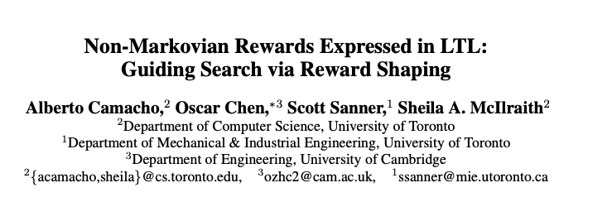
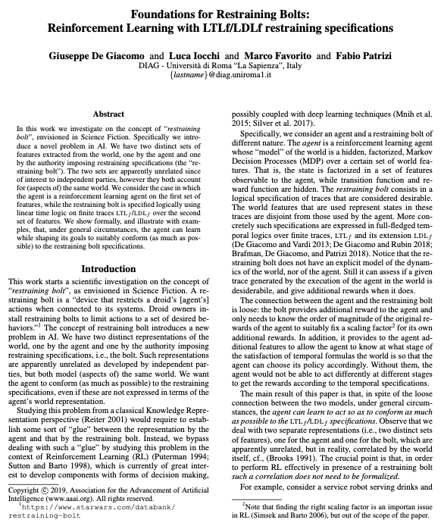
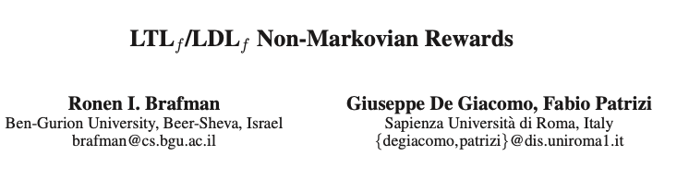
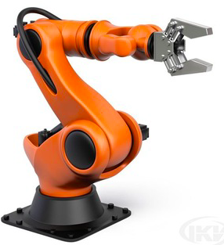


Papers
Experimental part with some practical examples
Sara Tozzo

Slide 3


Introduction
Restraining bolt: “a device that restricts a droid’s actions when connected to its systems. Droid owners install restraining bolts to limit actions to a set of desired behaviors.”
De Giacomo, Iocchi, Favorito and Patrizi,
Foundations for Restraining Bolts: Reinforcement Learning with LTLf/LDLf restraining specifications. 2019
Sara Tozzo

Slide 4


Problem for Artificial Intelligence
Two different representation of the world, apparently unrelated:
Agent: a reinforcement learning agent modeled by a Markov Decision Process (MDP)
Restraining Bolt (RB): logical specification of traces that are expressed in temporal logics over finite traces LTL_{f} /LDL_{f}
De Giacomo, Iocchi, Favorito and Patrizi,
Foundations for Restraining Bolts: Reinforcement Learning with LTLf/LDLf restraining specifications. 2019
Sara Tozzo

Slide 5

Connection
The bolt provides an additional reward and features to the agent.
The agent is able to act at different stages to get the rewards according to the temporal specifications.
De Giacomo, Iocchi, Favorito and Patrizi,
Foundations for Restraining Bolts: Reinforcement Learning with LTLf/LDLf restraining specifications. 2019
Sara Tozzo

Slide 6
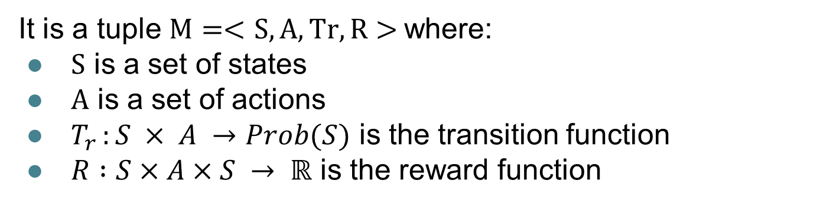
MDP: Markov Decision Process
It is a tuple $M=<S,A,Tr,R>$where:
$S$ is a set of states
$A$ is a set of actions
$T_{r }:S × A →Prob(S)$ is the transition function
$R :S×A×S → ℝ$ is the reward function
A solution to an MDP is a policy ⍴, assigns an action to each state, possibly conditioned on past states and actions.
De Giacomo, Iocchi, Favorito and Patrizi,
Foundations for Restraining Bolts: Reinforcement Learning with LTLf/LDLf restraining specifications. 2019
Sara Tozzo

Slide 7

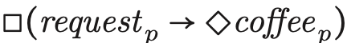
Linear Temporal Logic(LTL_{f})
How to reward a robot that “eventually delivers coffee each time it gets a request”?
The LTL_{f} is the classical linear time logic interpreted over finite traces, formed by a finite sequence of propositional interpretations.
“all coffee requests from person p will eventually be served”
De Giacomo, Iocchi, Favorito and Patrizi,
Foundations for Restraining Bolts: Reinforcement Learning with LTLf/LDLf restraining specifications. 2019
Giorgia Piernoli

Slide 8
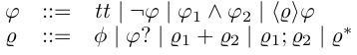


Linear Dynamic Logic(LDL_{f})
LDL_{f} is a proper extension of LTL_{f.}
Formally, LDL_{f} formulas $φ$ are defined as follows:
“all coffee requests from person p will eventually be served”
$$[{true}^{∗}]({request}_{p}→<{true}^{∗}>{coffee}_{p})$$
De Giacomo, Iocchi, Favorito and Patrizi,
Foundations for Restraining Bolts: Reinforcement Learning with LTLf/LDLf restraining specifications. 2019
Giorgia Piernoli

Slide 9
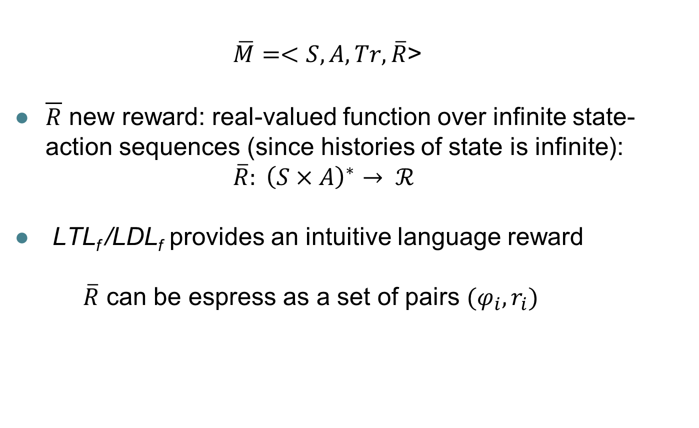
NMRDP’s: Non-Markovian Reward Decision Process
$\overline{M}=<S,A,Tr,\overline{R}$>
$\overline{R}$ new reward: real-valued function over infinite state-action sequences (since histories of state is infinite): $\overline{R}: {\left(S×A\right)}^{∗}→ ℛ$
LTL_{f} /LDL_{f} provides an intuitive language reward
$\overline{R}$ can be espress as a set of pairs $(φ_{i},r_{i})$
De Giacomo, Iocchi, Favorito and Patrizi,
Foundations for Restraining Bolts: Reinforcement Learning with LTLf/LDLf restraining specifications. 2019
Giorgia Piernoli

Slide 10
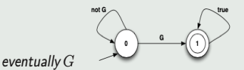
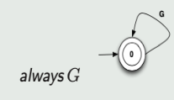
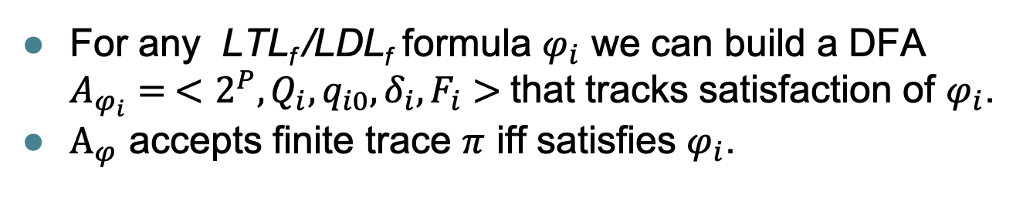
Computing Deterministic Finite Automata (DFA) for LTL_{f}/LDL_{f} formulas
For any LTL_{f} /LDL_{f} formula $φ_{i}$ we can build a DFA $A_{φ_{i}}= <2^{P},Q_{i},q_{i0},δ_{i},F_{i}>$that tracks satisfaction of $φ_{i}$.
$Α_{φ}$ accepts finite trace $π$ iff satisfies $φ_{i}$.
Giuseppe De Giacomo, Luca Iocchi, Fabio Patrizi
"Decision making with temporal goals: Reinforcement Learning for Restrainig Bolts"
Brafman, De Giacomo and Patrizi ,
LTLf /LDLf non-markovian rewards. AAAI, 2018.
Giorgia Piernoli

Slide 11
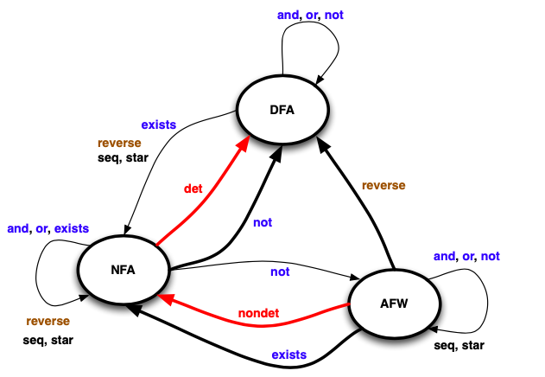
DFA (Deterministic Finite Automata), NFA (Non-Deterministic Finite Automata), AFW (Alternating Finite Automata on Words)
Implementable
device
Giuseppe De Giacomo, Moshe Y. Vardi: Synthesis for LTL and LDL on Finite Traces
Mathematical devices
Giuseppe De Giacomo, Luca Iocchi, Fabio Patrizi
"Decision making with temporal goals:
Reinforcement Learning for Restrainig Bolts"
Giorgia Piernoli

Slide 12
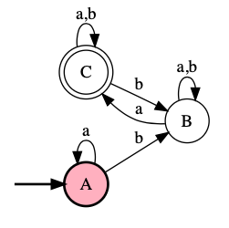
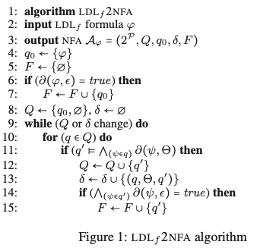
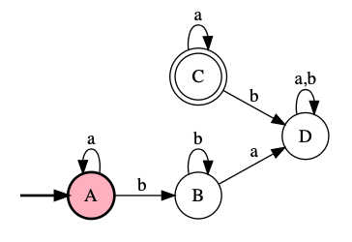

From NFA to DFA
Example:
NFA
DFA
The NFA can be transformed into a DFA also on-the-fly (no construction of $Α_{φ}$)
Brafman, De Giacomo and Patrizi ,
LTLf /LDLf non-markovian rewards. AAAI, 2018.
Giorgia Piernoli

Slide 13


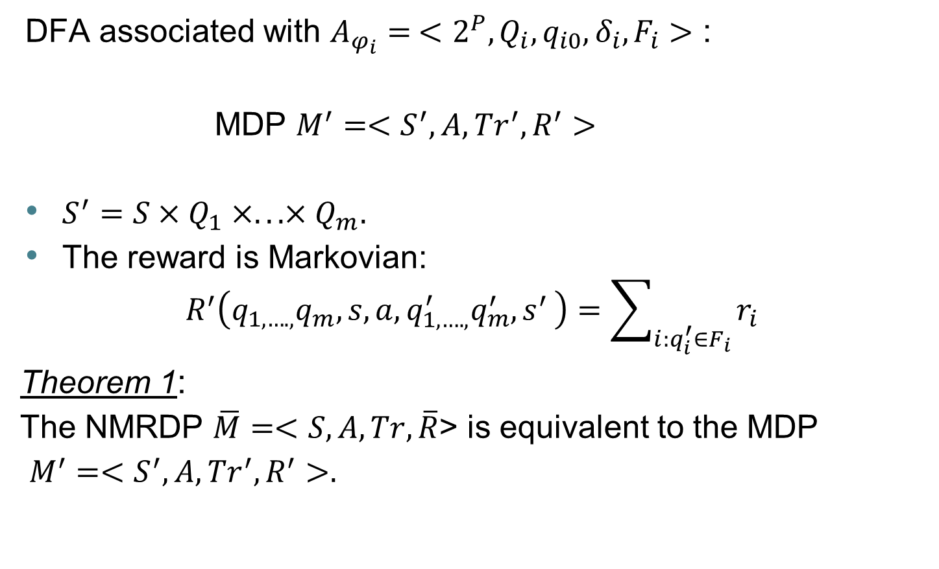
NMRDP with / rewards
DFA associated with $A_{φ_{i}}= <2^{P},Q_{i},q_{i0},δ_{i},F_{i}>$ :
MDP $M^{′}=<S^{′},A,{Tr}^{′},R^{′}>$
$S^{′}=S×Q_{1}×...×Q_{m}.$
The reward is Markovian:
$$R^{′}\left(q_{1,….,}q_{m},s,a,q_{1,….,}^{′}q_{m}^{′}{,s}^{′}\right)=\sum_{i:q_{i}^{′}∈F_{i}}{r_{i}}$$
Theorem 1:
The NMRDP $\overline{M}=<S,A,Tr,\overline{R}$> is equivalent to the MDP
$M^{′}=<S^{′},A,{Tr}^{′},R^{′}>.$
De Giacomo, Iocchi, Favorito and Patrizi,
Foundations for Restraining Bolts: Reinforcement Learning with LTLf/LDLf restraining specifications. 2019
Giorgia Piernoli

Slide 14

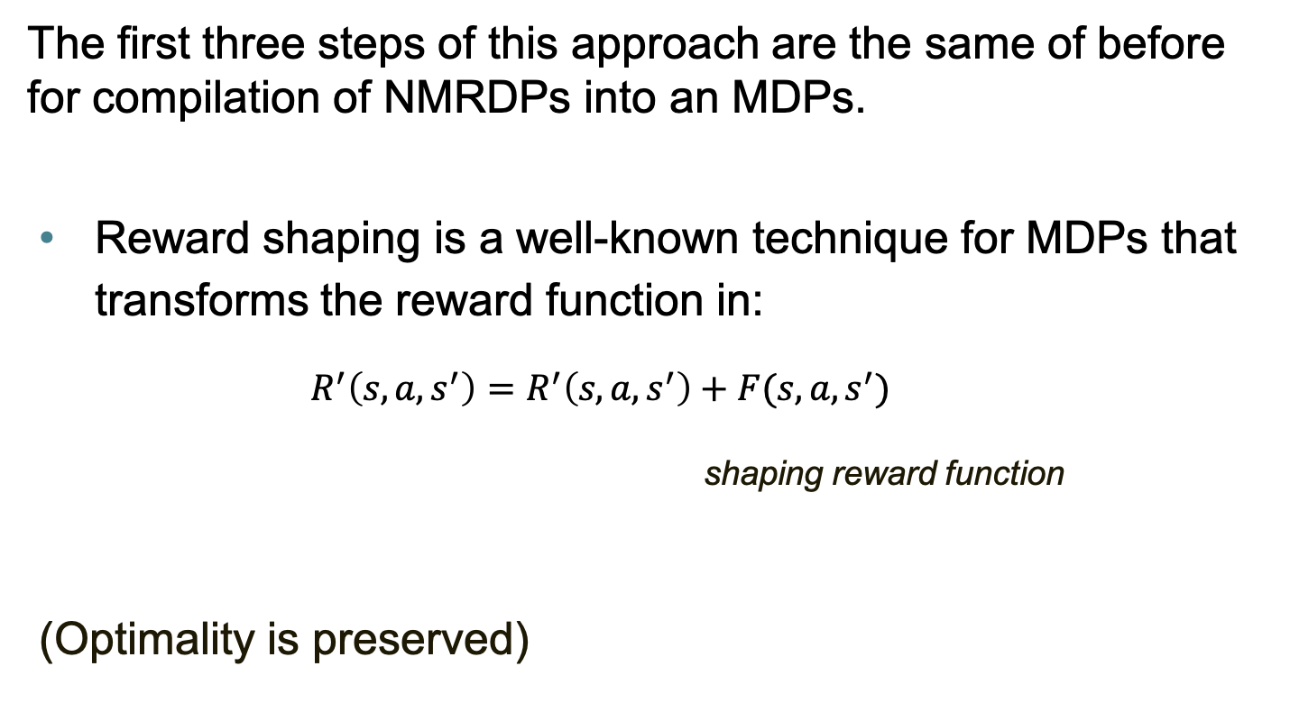
Another method: Reward shaping
The first three steps of this approach are the same of before for compilation of NMRDPs into an MDPs.
Reward shaping is a well-known technique for MDPs that transforms the reward function in:
$R^{′}\left(s,a,s^{′}\right)=R^{′}\left(s,a,s^{′}\right)+F(s,a,s^{′})$
shaping reward function
(Optimality is preserved)
Non-Markovian Rewards Expressed in LTL: Guiding Search via Reward Shaping Alberto Camacho,2 Oscar Chen,Scott Sanner,Sheila A. McIlraith
Giorgia Piernoli

Slide 15
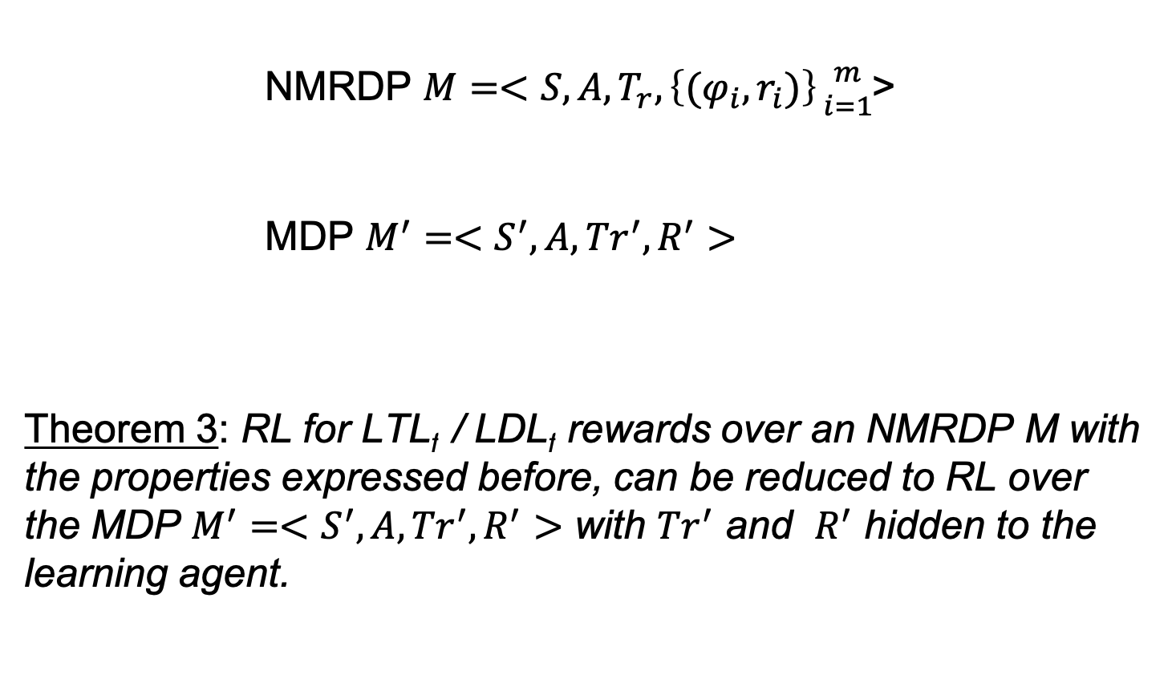
RL for NMRDP with LTL_{f}/LDL_{f} rewards
NMRDP $M=<S,A,T_{r},\left\{(φ_{i},r_{i})\right\}{m \atop i=1}$>
MDP $M^{′}=<S^{′},A,{Tr}^{′},R^{′}>$
Theorem 3: RL for LTL_{f} / LDL_{f} rewards over an NMRDP M with the properties expressed before, can be reduced to RL over the MDP $M^{′}=<S^{′},A,{Tr}^{′},R^{′}>$ with ${Tr}^{′}$ and $R^{′}$ hidden to the learning agent.
De Giacomo, Iocchi, Favorito and Patrizi,
Foundations for Restraining Bolts: Reinforcement Learning with LTLf/LDLf restraining specifications. 2019
Sara Tozzo

Slide 16
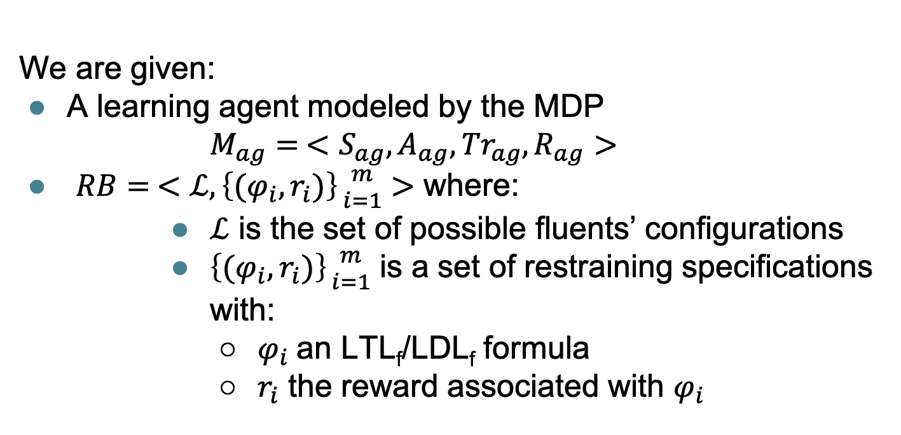
RL with LTL_{f} /LDL_{f} restraining specifications
We are given:
A learning agent modeled by the MDP
$M_{ag}= <S_{ag},A_{ag},{Tr}_{ag},R_{ag}>$
$RB= <ℒ, \left\{(φ_{i},r_{i})\right\}{m \atop i=1}>$ where:
$ℒ$ is the set of possible fluents’ configurations
$\left\{(φ_{i},r_{i})\right\}{m \atop i=1}$ is a set of restraining specifications with:
$φ_{i}$an LTL_{f}/LDL_{f} formula
$r_{i}$ the reward associated with $φ_{i}$
De Giacomo, Iocchi, Favorito and Patrizi,
Foundations for Restraining Bolts: Reinforcement Learning with LTLf/LDLf restraining specifications. 2019
Sara Tozzo

Slide 17
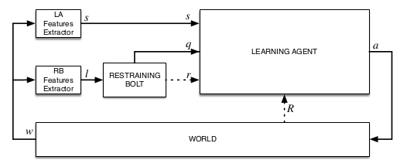


Learning Agent and Restraining Bolt
The agent receives reward based on $R_{ag}$and the pairs $\left(φ_{i},r_{i}\right)$
Solution: $\overline{ρ} : {(Q_{1}×…×Q_{m}×S)}^{∗}→A$
De Giacomo, Iocchi, Favorito and Patrizi,
Foundations for Restraining Bolts: Reinforcement Learning with LTLf/LDLf restraining specifications. 2019
Sara Tozzo

Slide 18

Main Result
Theorem 6: Reinforcement Learning with LTL_{f} / LDL_{f} restraining specifications $M_{ag}^{rb}=<M_{ag,}RB>$ with $M_{ag}= <S_{ag},A_{ag},{Tr}_{ag},R_{ag}>$ and
$RB= <ℒ, \left\{(φ_{i},r_{i})\right\}{m \atop i=1}>$ can be reduced to RL over the MDP
$M_{ag}^{q}=<Q_{1}×...×Q_{m}×S, A, T_{r}^{′′},R_{ag}^{′′}>$
and optimal policies${ ρ}_{ag}^{new}$ for${ M}_{ag}^{rb}$ can be learned by learning corresponding optimal policies for $M_{ag}^{q}$.
De Giacomo, Iocchi, Favorito and Patrizi,
Foundations for Restraining Bolts: Reinforcement Learning with LTLf/LDLf restraining specifications. 2019
Sara Tozzo

Slide 19
Experimental
Section
From:
To:
Our implementations:
Chess Moves Learning
&
Pick and Place Robot
(only sketched)
Original Paper experiments:
Breakout,
Sapientino,
Cocktail Party,
Minecraft.

Slide 20
Experiments General Setup
Assumptions
The simulator is able to model all the relevant evolutions of the world
There are sensors for Learning Agent and Restraining Bolt
Algorithm Specifications
SARSA algorithm
The policy must maximizes the cumulative reward
Episode reset/end conditions
DFA state satisfies formulas
DFA state is a fail
Maximum number of action reached
Flavio Lorenzi

Slide 21
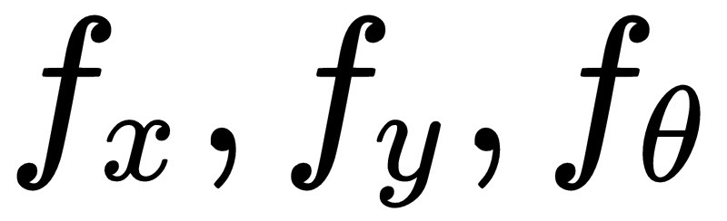
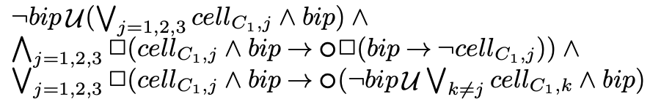
An experiment from the paper: Sapientino
RL Agent
Restraining Bolt
Can have two configurations:
OMNI: up, down, left, right actions
DIFFERENTIAL: forwards, backwards, turn left, turn right
The state representation is given by the agent pose:
So the agent just learn how to move through the grid
Specification:
Visit at least two cells per color for each color
Visit all triplets of each color, given an order among colors
<<Beeps on visited colors and on actions> Specifications are expressed with LTL formulas as:
Flavio Lorenzi

Slide 22

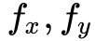
Implementation: Chess Moves -1 (abstract)
RL Agent
Restraining Bolt
Omnidirectional token robot that will learn different chess moves
Two important specifications:
Visit four cells for each color
Perform each chess move by respecting its particular order (not random moves)
<<Beeps on visited colors and on actions>>
The state representation is given
by the agent pose
The environment is a 5x7 grid
Focus on the reward
The cumulative R will be the sum of goals and fails coming from both part (RL and RB)
GoalStep + RAGoal + RAFail
Flavio Lorenzi

Slide 23
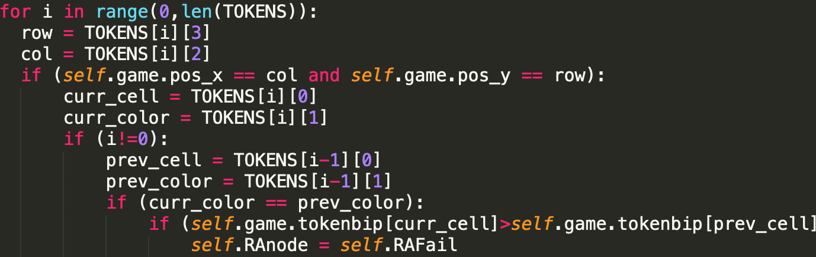
Implementation: Chess Moves -2 (code details)
Two python dictionary are implemented: tokenBip and colorBip
TOKENS = [ [’name', color', x, y], [’t2', green', 1,1], [’t3', green', 2,2], [’t4', green', 3,3]…]
-Class RewardAutoma
Each method is finalized to perform what is described by LTL formulas, according to the Restraining Bolts specifications
Main method:
update
-check for color and moves orders
-update the current state with RB rewards
check the ordered motion of the robot
-Class Chess
Here we can found all we need to perform the RL implementation:
Update positions, actions and colors + Reset functions + Rendering
Flavio Lorenzi

Slide 24
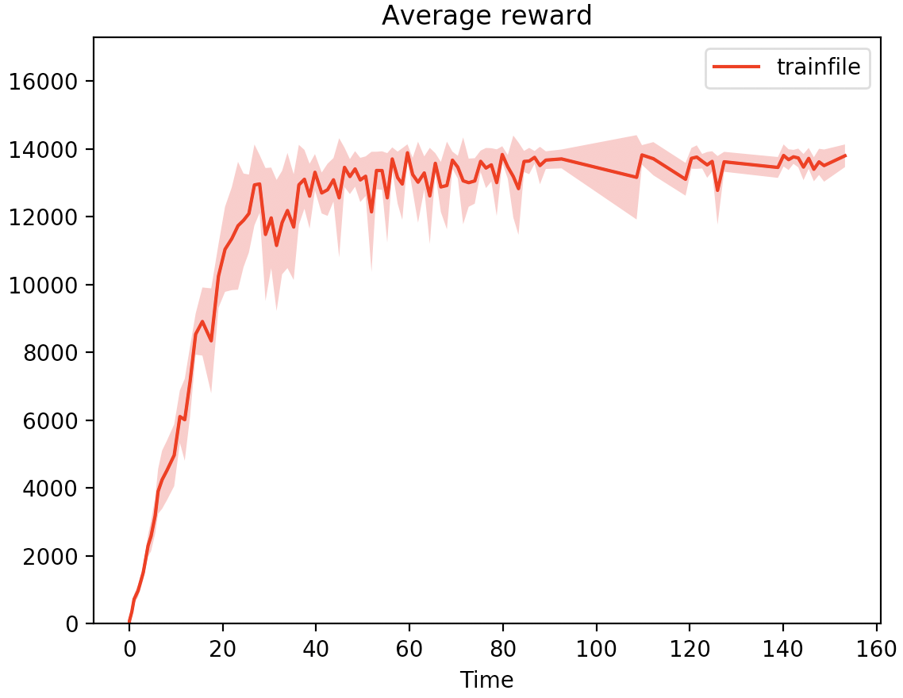
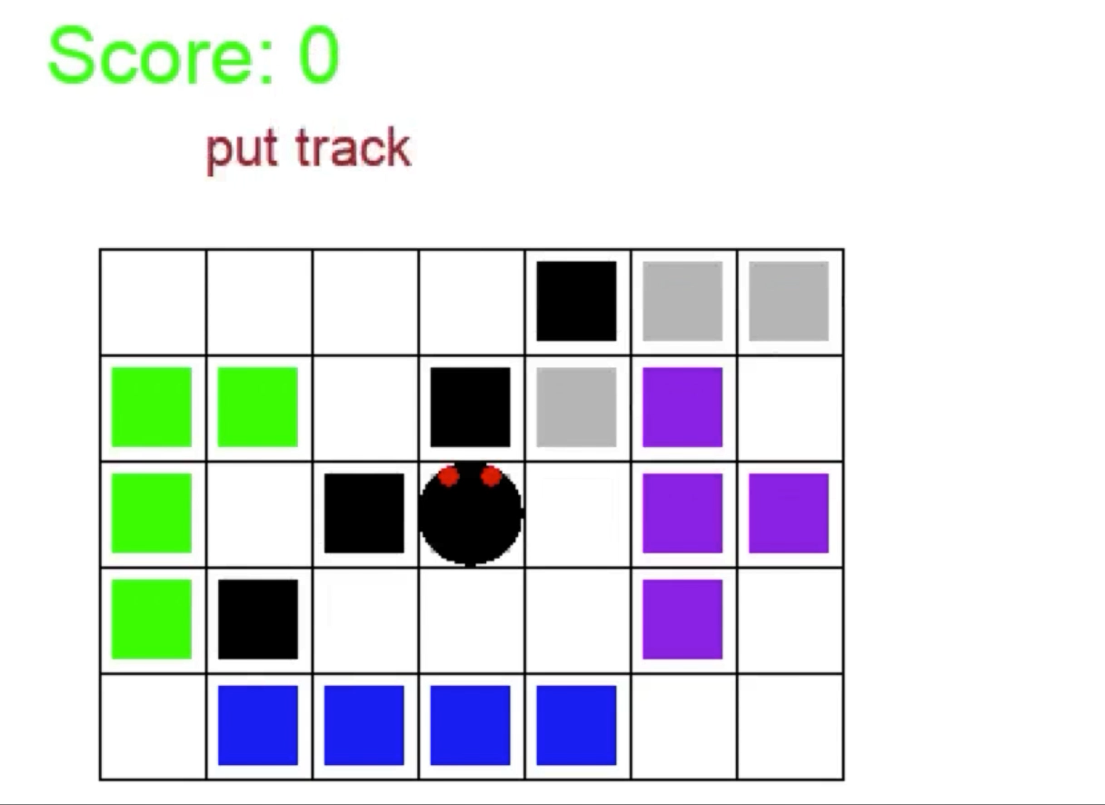



Implementation: Chess Moves -3 (results)
The agent has learned an optimal policy in a short time
Learning algorithm: SARSA
Alpha: -0.99
Epsilon: -2
Gamma: 0.99
n-steps: 20
StopOnGoal: True
MaxTime: 250
The robot computes in this sequence the task, keeping order
Knigth ➔ Rock ➔ King ➔ Bishops ➔ Queen
Flavio Lorenzi

Slide 25
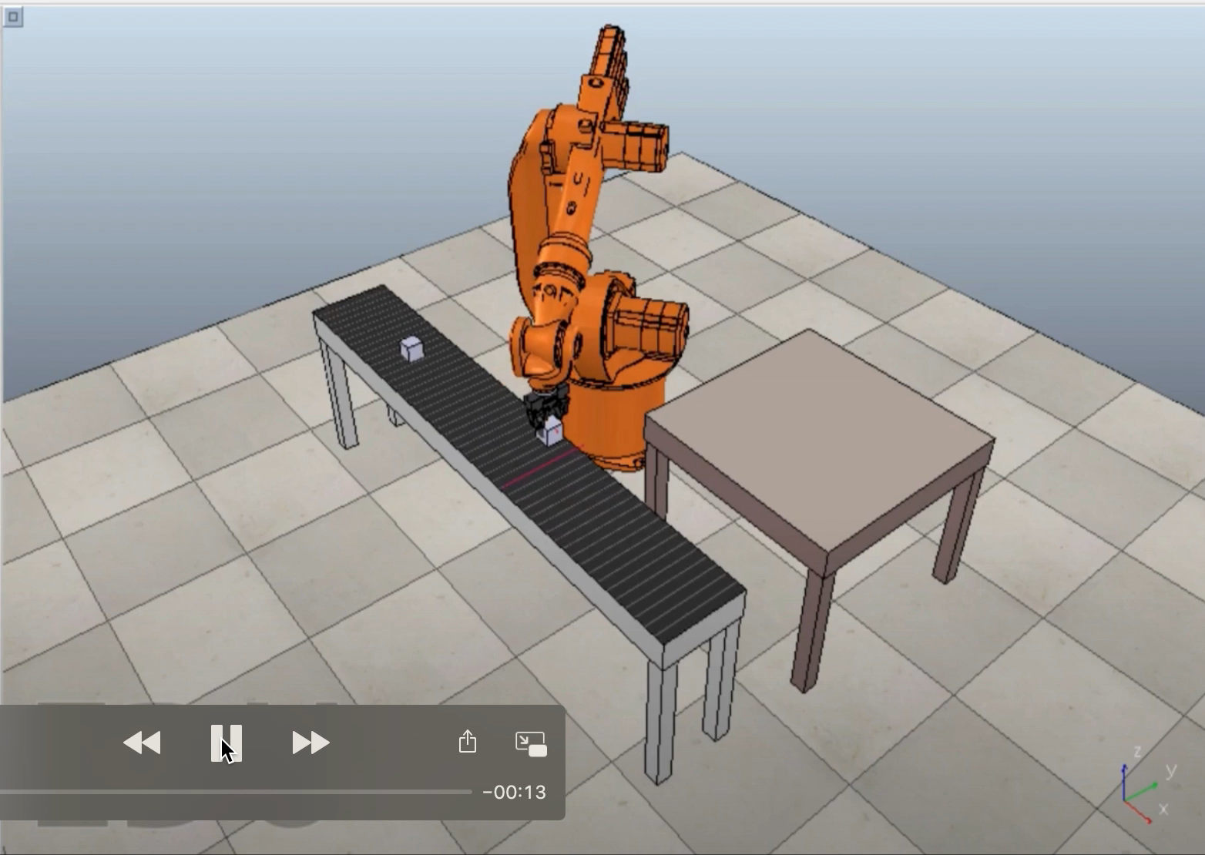
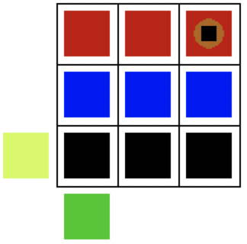
Pick and place task (still abstract)
- End effector (brown)
- Picked item (black)
Home
(or base)
Item location
Nicolò Mantovani

Slide 26
RL agent and RB
RL Agent
Restraining Bolts
The agent is a manipulator which must carry out the task of picking objects (once at time) from a conveyor belt and placing them on a table (actually, we have considered a relaxed problem).
The state representation is given by the position of the end-effector, the item location and if the end-effector is empty or not.
S1: place objects in a specific row (denoted by a color) following a specific order the grid is complete.
S2: place objects in a specific row (denoted by a color) in a random way the grid is complete.
The color of the current cell and the specific order are needed.
Nicolò Mantovani

Slide 27
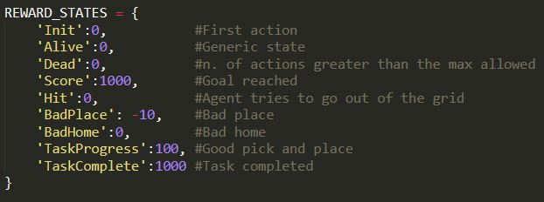
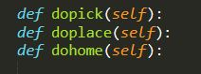

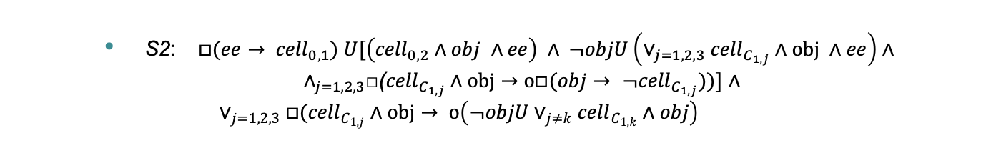

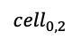
${LTL}_{f}$pick and place formulas and code
S2: $□(ee→ {cell}_{0,1}) U[\left({cell}_{0,2}∧obj ∧ee\right) ∧ ¬objU\left(∨_{j=1,2,3}{cell}_{C_{1,j}}∧obj ∧ee\right)∧{ ∧}_{j=1,2,3}\text{□(}{cell}_{C_{1,j}}∧obj→ο□(obj→ ¬{cell}_{C_{1,j}}))]$ $∧$
$$∨_{j=1,2,3}□({cell}_{C_{1,j}}∧obj→ ο\left(¬objU∨_{j≠k}{cell}_{C_{1,k}}∧obj\right)$$
$${cell}_{0,1}$$
$${cell}_{0,2}$$
Nicolò Mantovani

Slide 28
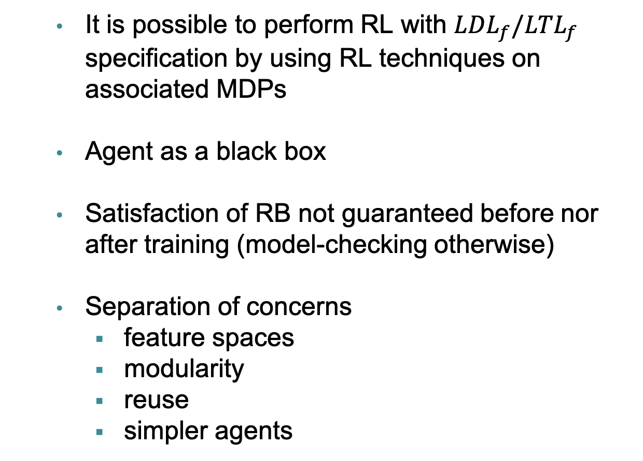
Conclusions
It is possible to perform RL with ${LDL}_{f}/{LTL}_{f}$ specification by using RL techniques on associated MDPs
Agent as a black box
Satisfaction of RB not guaranteed before nor after training (model-checking otherwise)
Separation of concerns
feature spaces
modularity
reuse
simpler agents
Nicolò Mantovani

Slide 29
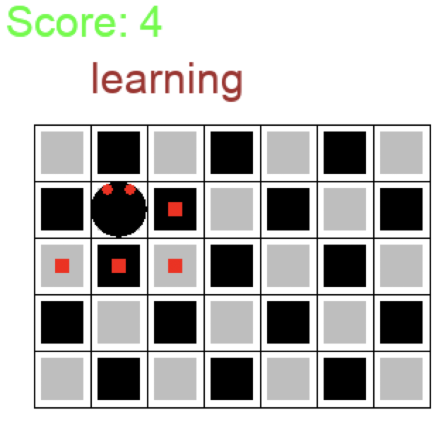
Future works
Implement a complete chess game using our agent and possibly with other learning agents
Fully implementation of pick and place task
Other examples (i.e.: consider an atonomous parking car)
Nicolò Mantovani

